Slide 1
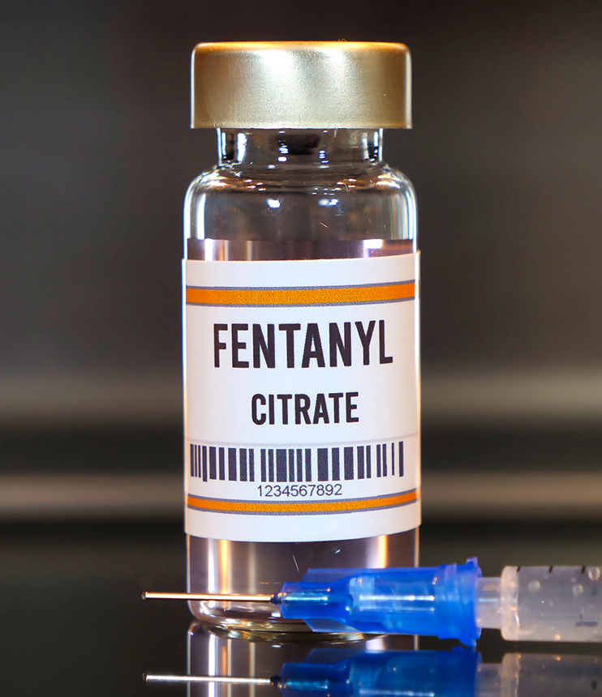
Opioid Epidemic
Presented by: Ilissa Garcia
Notes:
Line spacing + Page numbers

Slide 2
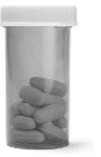

"What are the key factors associated with Opioid-related deaths, and how can data guide public health interventions and policies?"

Slide 3
Overview
The opiod epidemic presents a public health crisis, with a significant increase in Opioid-related deaths in recent years. This project aims to address this urgent issue by analyzing data to understand the underlying factors contributing to these deaths. Understanding the causes and patterns of Opioid-related deaths is crucial for developing evidence-based interventions, informing policy decisions, and saving lives. My analysis seeks to provide valuable insights that can make a meaningful impact on public health efforts to combat the Opioid epidemic.
Notes:
Opioids are a type of drug that comes from the poppy plant or they are made in labs to work in a similar way. They are often used to treat pain and include drugs like morphine, fentanyl, and tramadol. However, if people use opioids in ways they're not supposed to, for too long, or without a doctor's guidance, they can become addicted and face serious health risks. In 2019, around 600,000 people died worldwide because of drugs, and about 80% of these deaths were due to opioids. Even though there are good treatments for opioid addiction that can help prevent overdosing, less than 10% of people who need these treatments are not getting them.

Slide 4
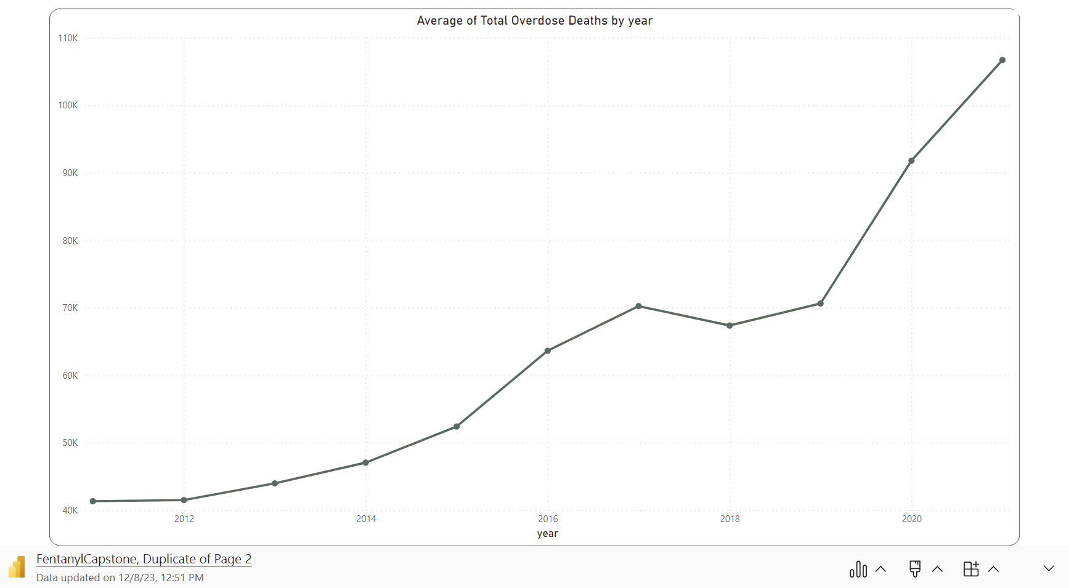
Notes:
Average of total overdose deaths by year from 2011 to 2021. There is a clear upward trend in the average number of deaths. Starting at around 40,000 deaths in 2011, there's a gradual increase each year, with a slight plateau around 2018. However, by 2021, the average dramatically spikes to just over 110,000 deaths. This sharp increase at the end of the graph highlights a severe escalation in this public health issue during that year.
In 2020, an average of 44 people died each day from Opioids.
Today Opioids kill more than 136 Americans every day.

Slide 5
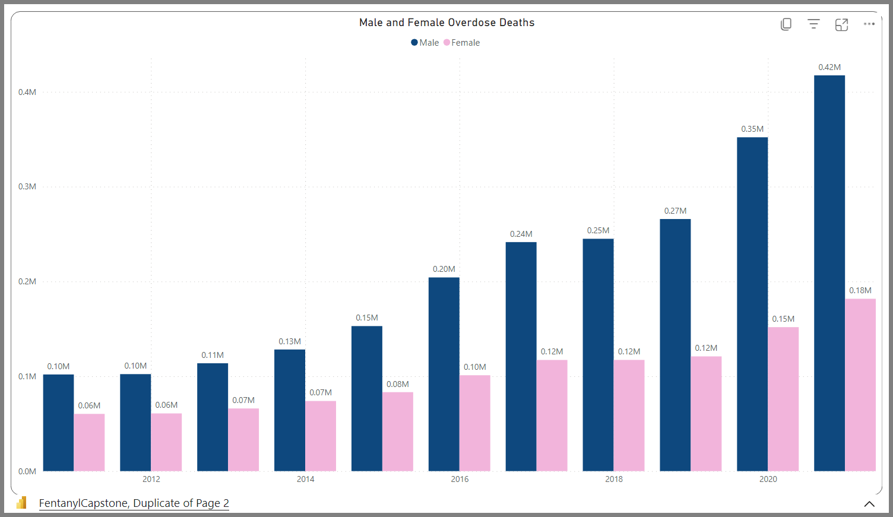
Notes:
2011-2021
The bar graph displays male and female overdose deaths from 2011 to 2020. It shows a consistent increase in overdose deaths for both genders over the years. Male overdose deaths are represented by the blue bars and female overdose deaths by the pink bars. In every year male overdose deaths outnumber female deaths.
This trend of higher male fatalities continues throughout the years, with a notable jump in male overdose deaths in 2020, reaching 0.42 million, while female overdose deaths also increased but to a lesser extent, at 0.18 million. The graph illustrates a worrying upward trajectory in overdose deaths for both males and females, with a particularly sharp increase in 2020.

Slide 6
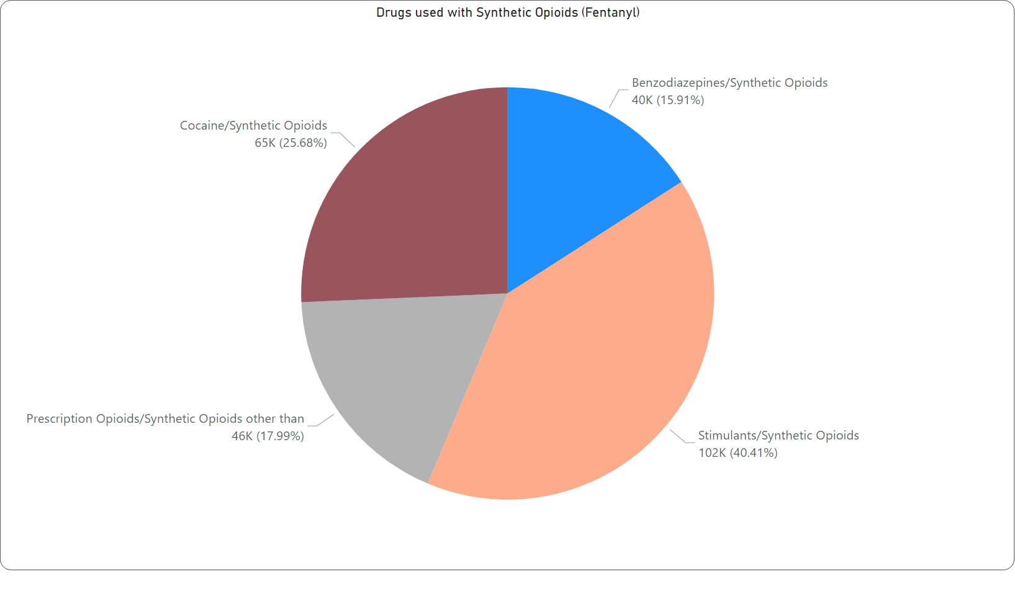
Notes:
Pie – 2011-2021
This pie chart presents data on the use of various drugs in combination with synthetic opioids, particularly Fentanyl and the corresponding amount of overdose deaths. The largest portion of the chart shows that Stimulants are most commonly used with synthetic opioids, accounting for 102K cases or 40.41% of the total. Prescription Opioids combined with synthetic opioids other than Fentanyl account for 46K cases, making up 17.99% of the total. The smallest segment shows that Benzodiazepines are used with synthetic opioids in 40K cases, which is 15.91% of the total.

Slide 7
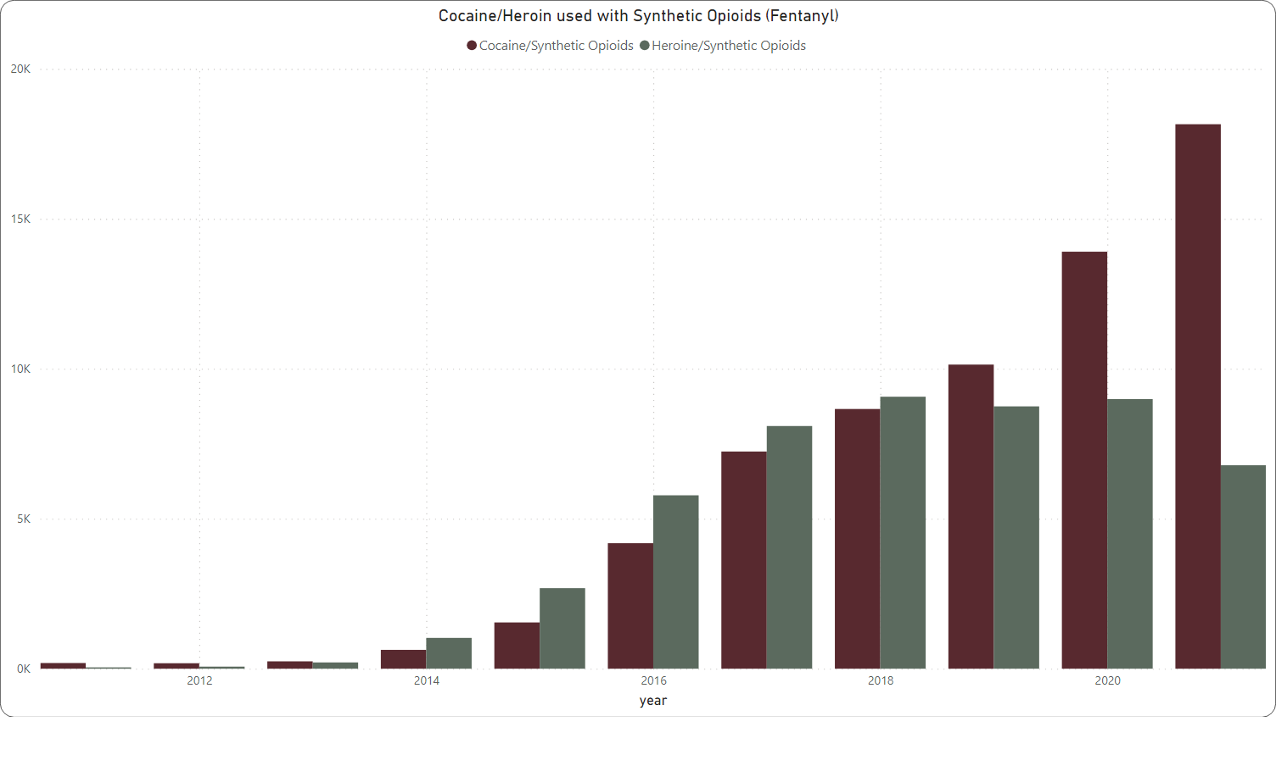
Notes:
This bar chart indicates the number of deaths from cocaine/heroin used with synthetic opioids (presumably Fentanyl) from 2011 to 2021. It appears that deaths from cocaine used with synthetic opioids increase over time, but not as drastically as heroin used with synthetic opioids, which shows a more significant and steady increase throughout the years.
This clearly demonstrates that while overdose deaths from cocaine and heroin with synthetic opioids are a significant concern, they are part of a larger trend of increasing overdose fatalities.

Slide 8
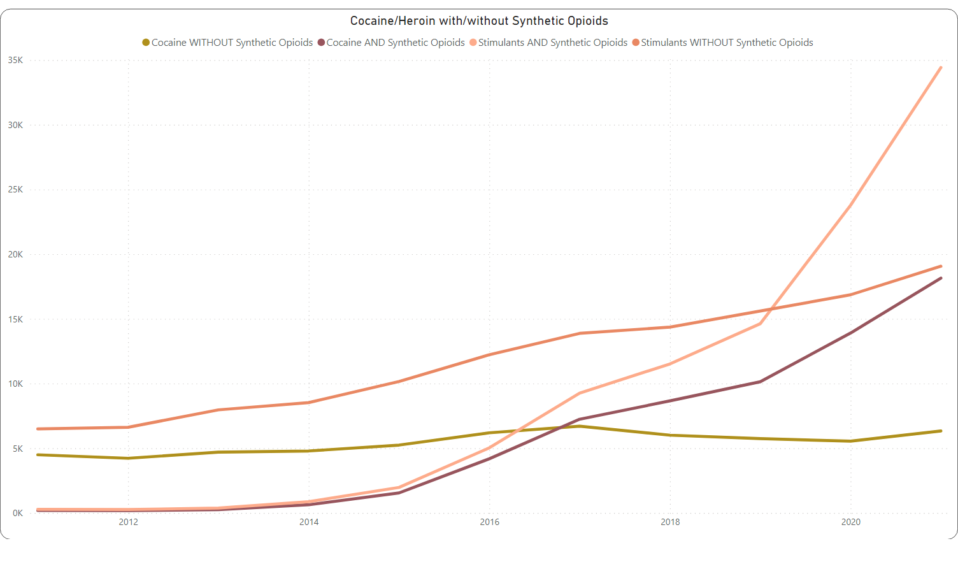
Notes:
The line graph shows four trends from 2011 to 2021 related to drug overdose deaths:
From this graph, we can see that the use of cocaine and stimulants without synthetic opioids remains relatively stable and low compared to the use of these substances with synthetic opioids. Particularly, the trend for stimulants with synthetic opioids shows a drastic increase, far surpassing the other categories, especially from around 2016 onwards.
When comparing this graph to the previous one, the previous chart also showed a significant increase in overdose deaths related to synthetic opioids. Both charts illustrate the dramatic impact that synthetic opioids have when combined with other substances like cocaine and stimulants, leading to an escalation in overdose deaths.
The last chart presented a combined view of cocaine/heroin used with synthetic opioids against the total overdose deaths, showing a direct comparison within the same category of drugs. This graph, however, breaks down the use of cocaine and stimulants with and without synthetic opioids, providing a different view of how the combination with synthetic opioids is driving the increase in overdose deaths. Both graphs highlight the critical role of synthetic opioids in the surge of drug overdose deaths.

Slide 9
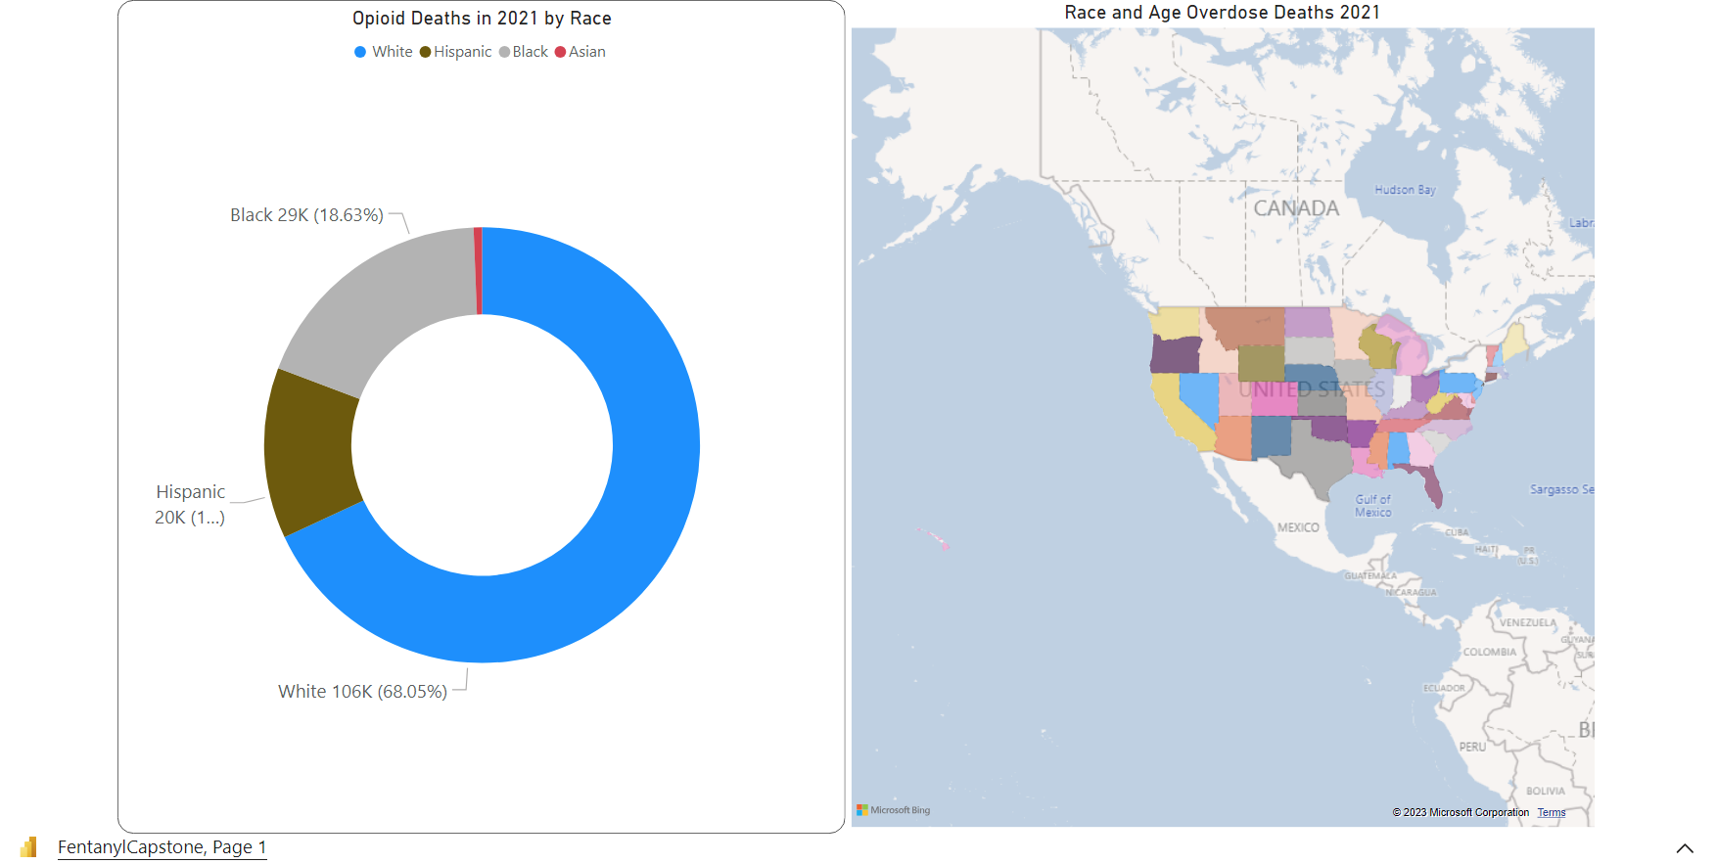
Notes:
The donut chart shows opioid-related deaths in 2021 by race. White individuals with the largest proportion, at 68.05%, followed by Black individuals at 18.63%, and Hispanic individuals, who appear to make up just over 10%. Asian individuals have the smallest share. The data suggests that opioid deaths disproportionately affect White individuals, but also indicate a significant impact on Black and Hispanic communities.
Currently, 71% of preventable opioid deaths occur among those ages 25 to 54, and the number of deaths among individuals 55 and older is growing rapidly.
We should be enhancing data collection to inform targeted interventions, expanding access to addiction treatment and mental health services, and improving prescription monitoring. Distribution of naloxone and implementing harm reduction programs, alongside socioeconomic support initiatives, are also critical. Healthcare providers should receive training in cultural competence, and drug policies should shift toward treatment over incarceration. Engaging community leaders in these efforts ensures culturally sensitive approaches, and advocating for policies that tackle the root social determinants of health can provide systemic, long-term solutions to this complex problem.

Slide 10
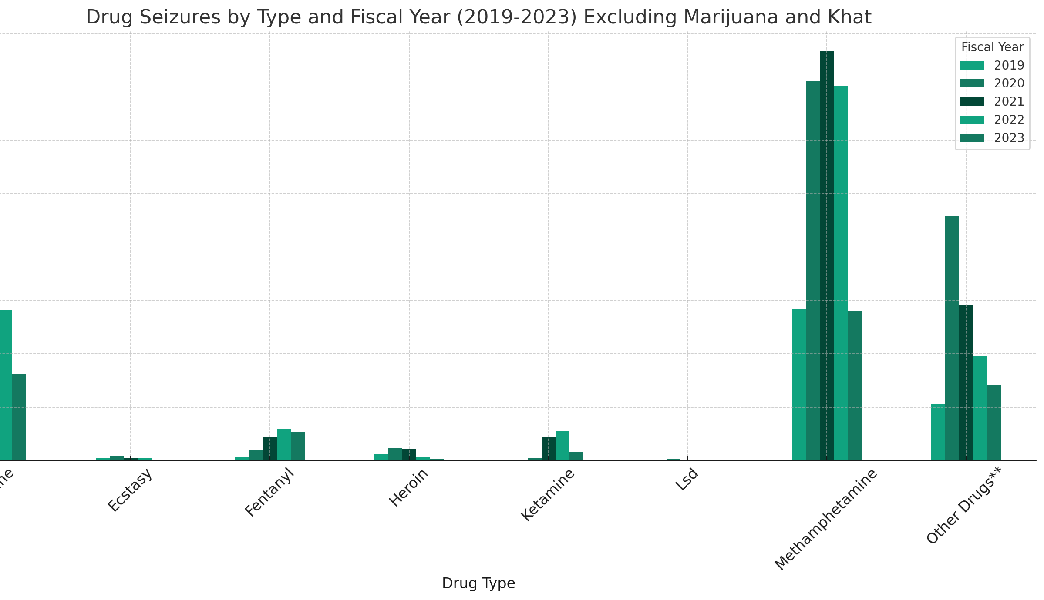
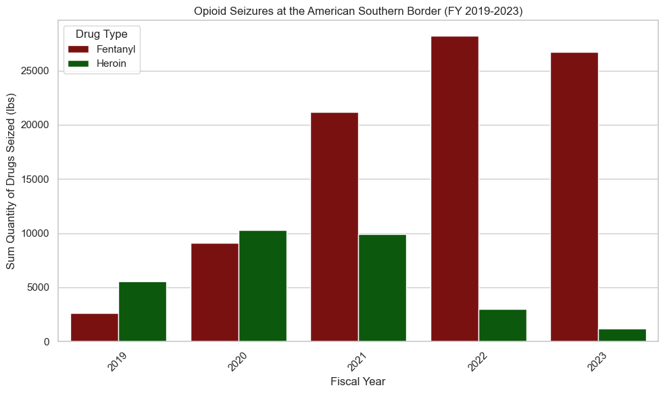
Our Southern Border
The southern border of the United States plays a crucial role in the opioid crisis affecting America. This border is a key entry point for illegal opioids, including highly potent drugs like fentanyl and heroin. Drug trafficking organizations frequently use this route for smuggling, leading to an increased availability of opioids in the U.S. This ease of access contributes to the growing issue of opioid misuse and overdose deaths, particularly with fentanyl, which is extremely potent and dangerous even in small quantities.
Controlling drug trafficking across the expansive southern border presents significant challenges for law enforcement and border control agencies. The influx of opioids through this route has broad social and economic impacts, affecting healthcare, workforce productivity, and community well-being. This situation also influences policy decisions regarding border security and drug control strategies. Effective management of this requires not only stringent border security measures but also collaboration with Mexico to dismantle drug trafficking networks, as well as public health interventions to address addiction and provide treatment.
Notes:
These charts illustrate a significant increase in fentanyl seizures, indicating its rising involvement in the opioid crisis in America, as fentanyl is extremely potent and linked to many overdose deaths. The broader drug seizure data, including high volumes of cocaine and methamphetamine, suggests that while opioids are a major issue, the substance abuse problem in America is diverse and expansive.

Slide 11
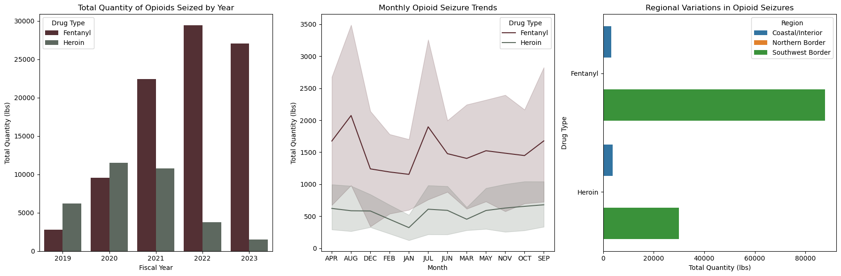
From 2020 to 2022, the amount of Fentanyl confiscated at the Mexico-U.S. border rose significantly, by 164%. In 2023 they have already seized approximately 21,846 pounds (or around 9,909 kilograms) of Fentanyl, exceeding the total amount captured in the previous year, which was about 14,104 pounds (or around 6,397 kilograms). The majority of these Fentanyl seizures took place in California and Arizona, and both states have experienced an uptick in the capture of this drug from 2020 to 2023.

Slide 12

Drug Courts
About half of the 7 million people being supervised by the criminal justice system in some way (like being in prison or on probation) have a drug abuse or addiction problem. However, just punishing these individuals for their drug abuse isn't effective. It doesn't work well as a way to ensure public safety, especially when their crimes are directly linked to their drug use.
A comprehensive drug court system typically costs between $2,500-$4,000 annually for each offender, compared to $20,000-$50,000 per person per year to incarcerate a drug-using offender.
Increasing the number of drug courts is a crucial in tackling the opioid overdose crisis. These specialized courts prioritize rehabilitation over punishment, directly addressing the underlying issue of addiction, which is often the root cause of drug-related offenses. Drug courts provide essential overdose prevention education and access to a range of support services, including addiction treatment, mental health counseling, and social services, all vital for overcoming opioid addiction. Furthermore, this approach is cost-effective compared to incarceration. It enhances community safety and health by reducing the burden on healthcare and law enforcement. With customized treatment plans, drug courts offer a more personalized and effective solution than traditional criminal justice proceedings. The regular monitoring and drug testing in these courts ensure accountability and provide a structured recovery environment, making drug courts a compassionate and effective approach to mitigate the opioid crisis.

Slide 13
Prescription drug monitoring programs (PDMPs)
Prescription Drug Monitoring Programs (PDMPs) are digital systems managed by state agencies. They keep track of how controlled substances, like certain prescription drugs, are prescribed and given out. PDMPs are used by doctors and pharmacists to see a patient's prescription history. Law enforcement can use them to spot illegal drug distribution or places that over-prescribe drugs. State medical boards also use PDMPs to watch for prescribers who might be giving out too many controlled substances. The drugs monitored and who can access the system, as well as how the system works, can differ from state to state.
There's some evidence showing that PDMPs can reduce both the amount and number of opioid prescriptions. They may also help decrease opioid overdose deaths. States with PDMPs often see less opioid misuse and fewer hospital admissions due to opioid-related issues compared to states without PDMPs. PDMPs can also reduce "doctor shopping," where patients visit multiple doctors to get the same drug. Experts suggest that PDMPs should be easy to use, accessible across states, open for all prescribers to register, include mandatory reporting from pharmacies, undergo regular evaluations, and be required in EDs.
Benefits
Reduced Overdose Deaths
Reduced Elicit Drug use

Slide 14
Conclusion
In conclusion, this capstone project has shed light on critical aspects of the fentanyl crisis. My analysis revealed trends, including the geographical hotspots of fentanyl-related incidents, demographic factors influencing vulnerability. These findings underscore the urgent need for comprehensive strategies and targeted interventions to combat this public health crisis effectively. To mitigate its devastating impact, policymakers, law enforcement agencies, healthcare providers, and community organizations should work collaboratively. While my study has provided valuable insights, it also highlights the complexity of the issue and the necessity for ongoing research and data-driven initiatives to inform evidence-based solutions. Addressing the fentanyl crisis demands a multi-faceted approach that combines data analysis, public awareness, and policy action to save lives and protect communities.
PREVENATIVE ACTIONS
Increasing the availability of opioid treatment, including those dependent on prescription opioids.
Reducing irrational or inappropriate opioid prescribing.
Monitoring opioid prescribing and dispensing.
Limiting inappropriate over the counter sales of opioids.

